Slide 1
- Bearings
- Angles of Elevation and Depression

Slide 2
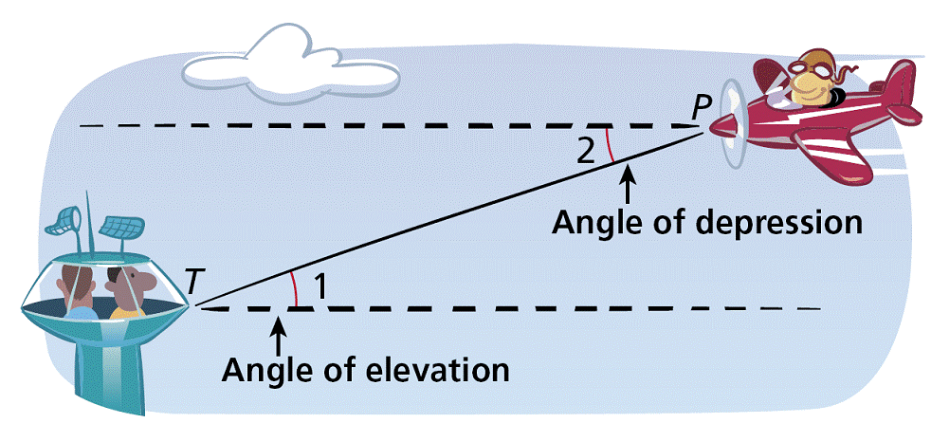
Angles of Elevation and Depression
An angle of elevation is the angle formed by a horizontal line and a line of sight to a point above the line. In the diagram, ∠1 is the angle of elevation from the tower T to the plane P.
An angle of depression is the angle formed by a horizontal line and a line of sight to a point below the line. ∠2 is the angle of depression from the plane to the tower.

Slide 3
Definitions
Angle of Elevation - is the angle between the horizontal and the line of sight to an object above the horizontal.
Angle of Depression - is the angle between the horizontal and the line of sight to an object beneath the horizontal.

Slide 4
Vocabulary
Angle of Depression and Angle of Elevation are Equal
Horizontal Line
Angle of Depression
Angle of Elevation
Horizontal Line

Slide 5
Identifying Angles of Elevation and Depression

Slide 6
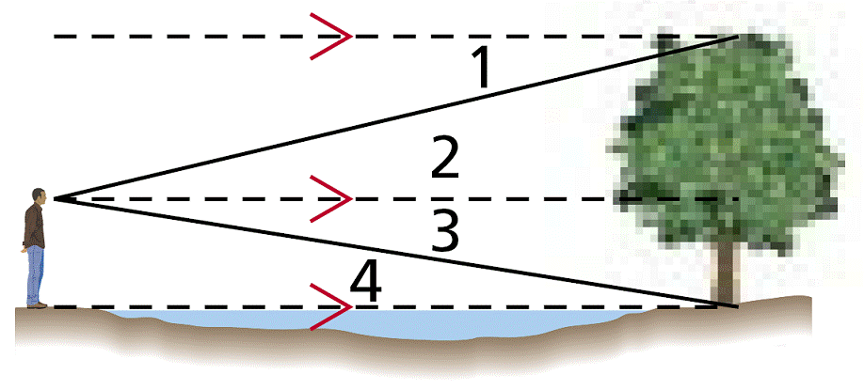
Example 1: Classifying Angles of Elevation and Depression
Classify each angle as an angle of elevation or an angle of depression.
∠1
∠1 is formed by a horizontal line and a line of sight to a point below the line. It is an angle of depression.

Slide 7
Example 2: Classifying Angles of Elevation and Depression
Classify each angle as an angle of elevation or an angle of depression.
∠4
∠4 is formed by a horizontal line and a line of sight to a point above the line. It is an angle of elevation.

Slide 8
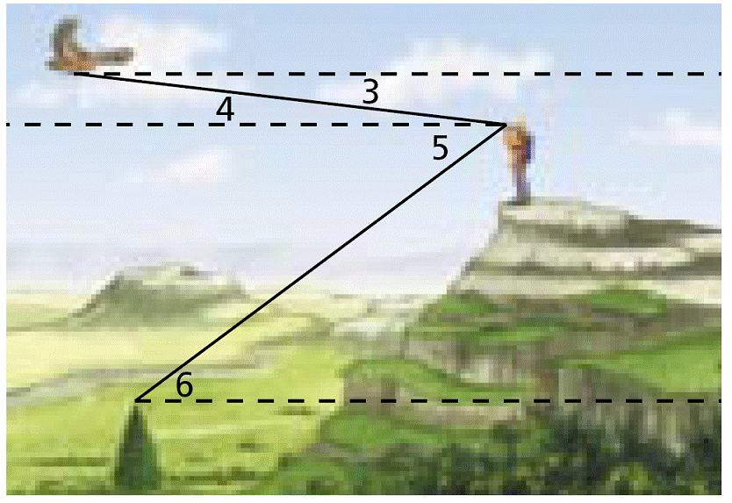
Check It Out! Example 3
Use the diagram above to classify each angle as an angle of elevation or angle of depression.
3a. ∠5
∠5 is formed by a horizontal line and a line of sight to a point below the line. It is an angle of depression.
3b. ∠6
∠6 is formed by a horizontal line and a line of sight to a point above the line. It is an angle of elevation.

Slide 9

A Line of Sight Example
You sight a rock climber on a cliff at a 32º angle of elevation. The horizontal ground distance to the cliff is 305 m. Find the line of sight distance to the rock climber.
x
305 m

Slide 10
An Airplane Example
An airplane pilots sights a life raft at a 26º angle of depression. The airplane’s altitude is 3 km. What is the airplane’s surface distance d from the raft?
3 km
d

Slide 11

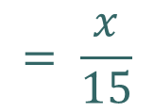
An Example
A surveyor is standing 15 m from the base of a large tree. The surveyor measures the angle of elevation to the top of the tree as 71.5°. How tall is the tree?
tan 71.5°
$$= \frac{x}{15}$$
?
y = 15 (tan 71.5°)
71.5°
$$y≈44.8 m$$
15 m

Slide 12
Angle of Elevation and Depression
Suppose the angle of depression from a lighthouse to a sailboat is 5.7º. If the lighthouse is 150 ft tall, how far away is the sailboat?
5.7º
150 ft.
5.7º
x
Construct a triangle and label the known parts. Use a variable for the unknown value.

Slide 13
Angle of Elevation and Depression
Suppose the angle of depression from a lighthouse to a sailboat is 5.7º. If the lighthouse is 150 ft tall, how far away is the sailboat?
5.7º
150 ft.
5.7º
x
Set up an equation and solve.

Slide 14
Angle of Elevation and Depression
150 ft.
5.7º
x
x is approximately 1,503 ft.

Slide 15
Compass points
360°
000°
N
045°
315°
NW
NE
270°
W
E
090°
SW
SE
225°
135°
S
180°

Slide 16
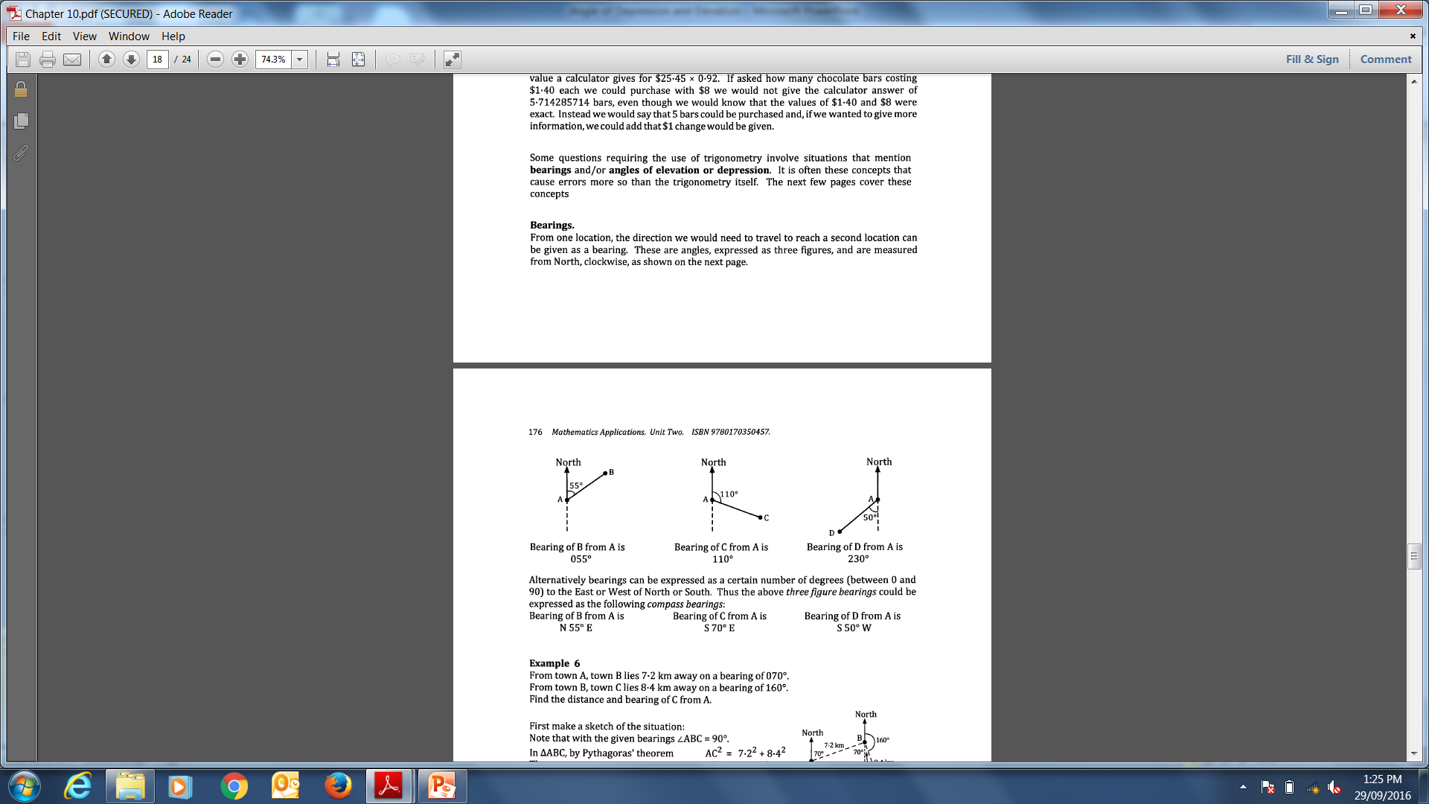
Bearings
The true bearing to a point is the angle measured in degrees in a clockwise direction from the north line. Always given using three figures.
Bearing of B from A is 055˚
Bearings – The Key Points
True bearings are a measure of direction taken from North.
True bearings are always measured in a clockwise direction
True bearings are always written in 3 figures.

Slide 17
A bearing is a way of defining direction as an angle measured from due North in a clockwise direction
N
B
243°
A
What is the bearing of A from B ?
In other words if you are at B and facing North, by how many degrees must you turn in a clockwise direction until you are facing A ?

Slide 18
A bearing is a way of defining direction as an angle measured from due North in a clockwise direction
N
N
B
063°
243°
A
What is the bearing of A from B ?
In other words if you are at B and facing North, by how many degrees must you turn in a clockwise direction until you are facing A ?

Slide 19
A bearing is a way of defining direction as an angle measured from due North in a clockwise direction
N
N
B
063°
243°
A
The bearing of B from A is 063°
The bearing of A from B is 243°

Slide 20
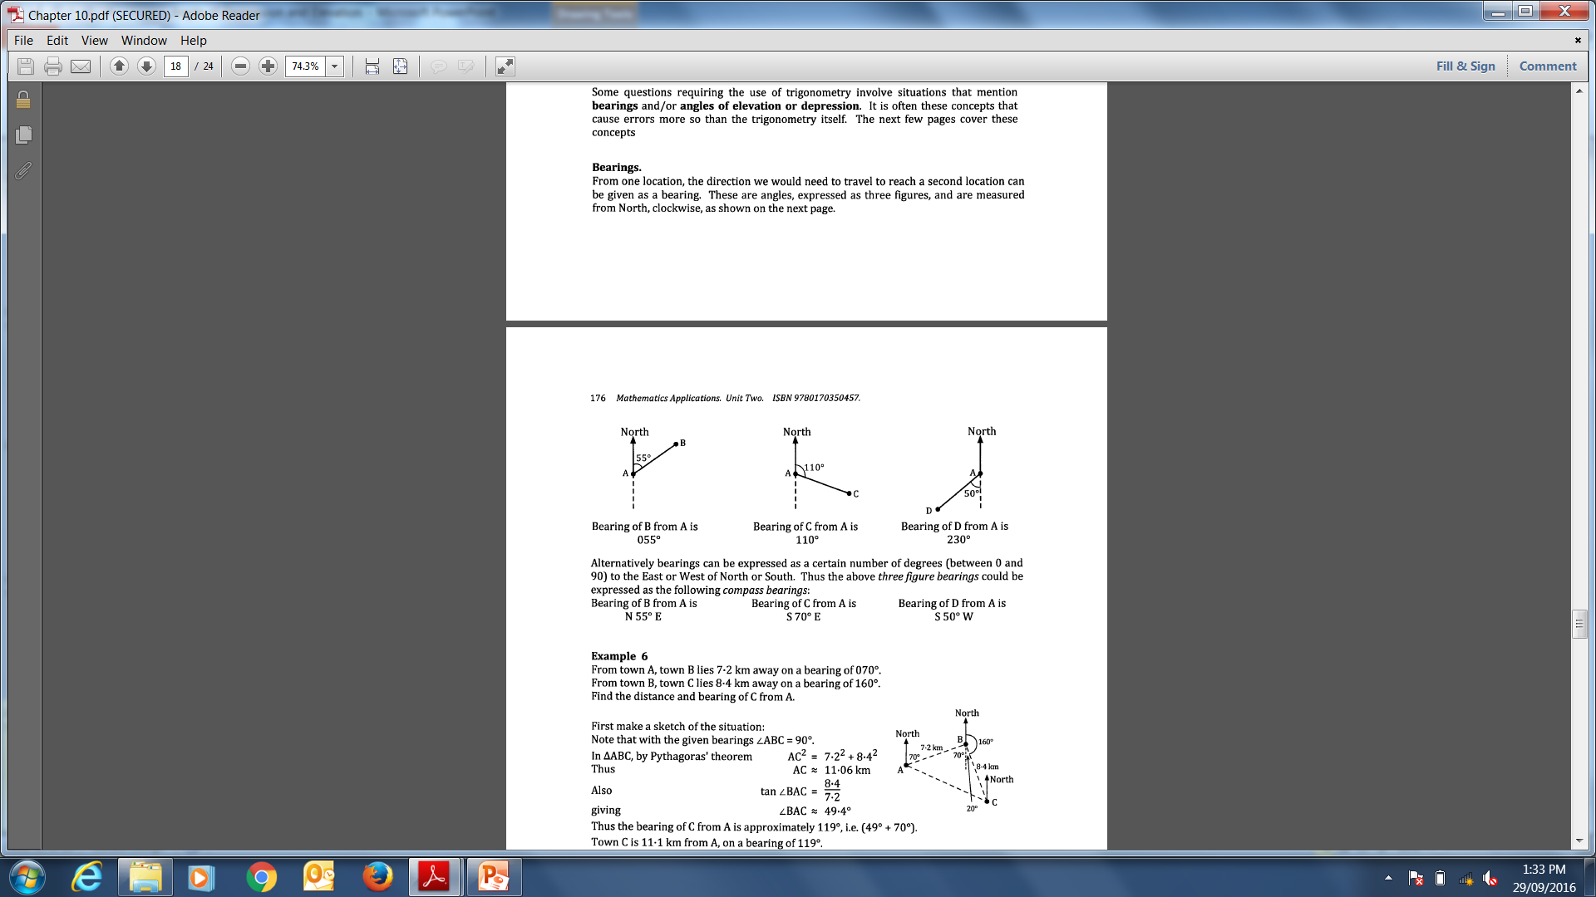
Bearings
The conventional bearing, also known as direction, of a point is stated as the number of degrees east or west of the north-south line. Always measured from north or south in an east or west direction.
N 55˚ E
S 70˚ E
S 50˚ W

Slide 21
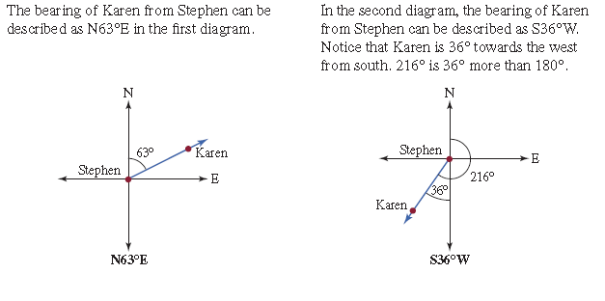

Slide 22
